Slide 1
SOFTWARE DEVELOPMENT OFFICER
MRA – Practical Project

Slide 2
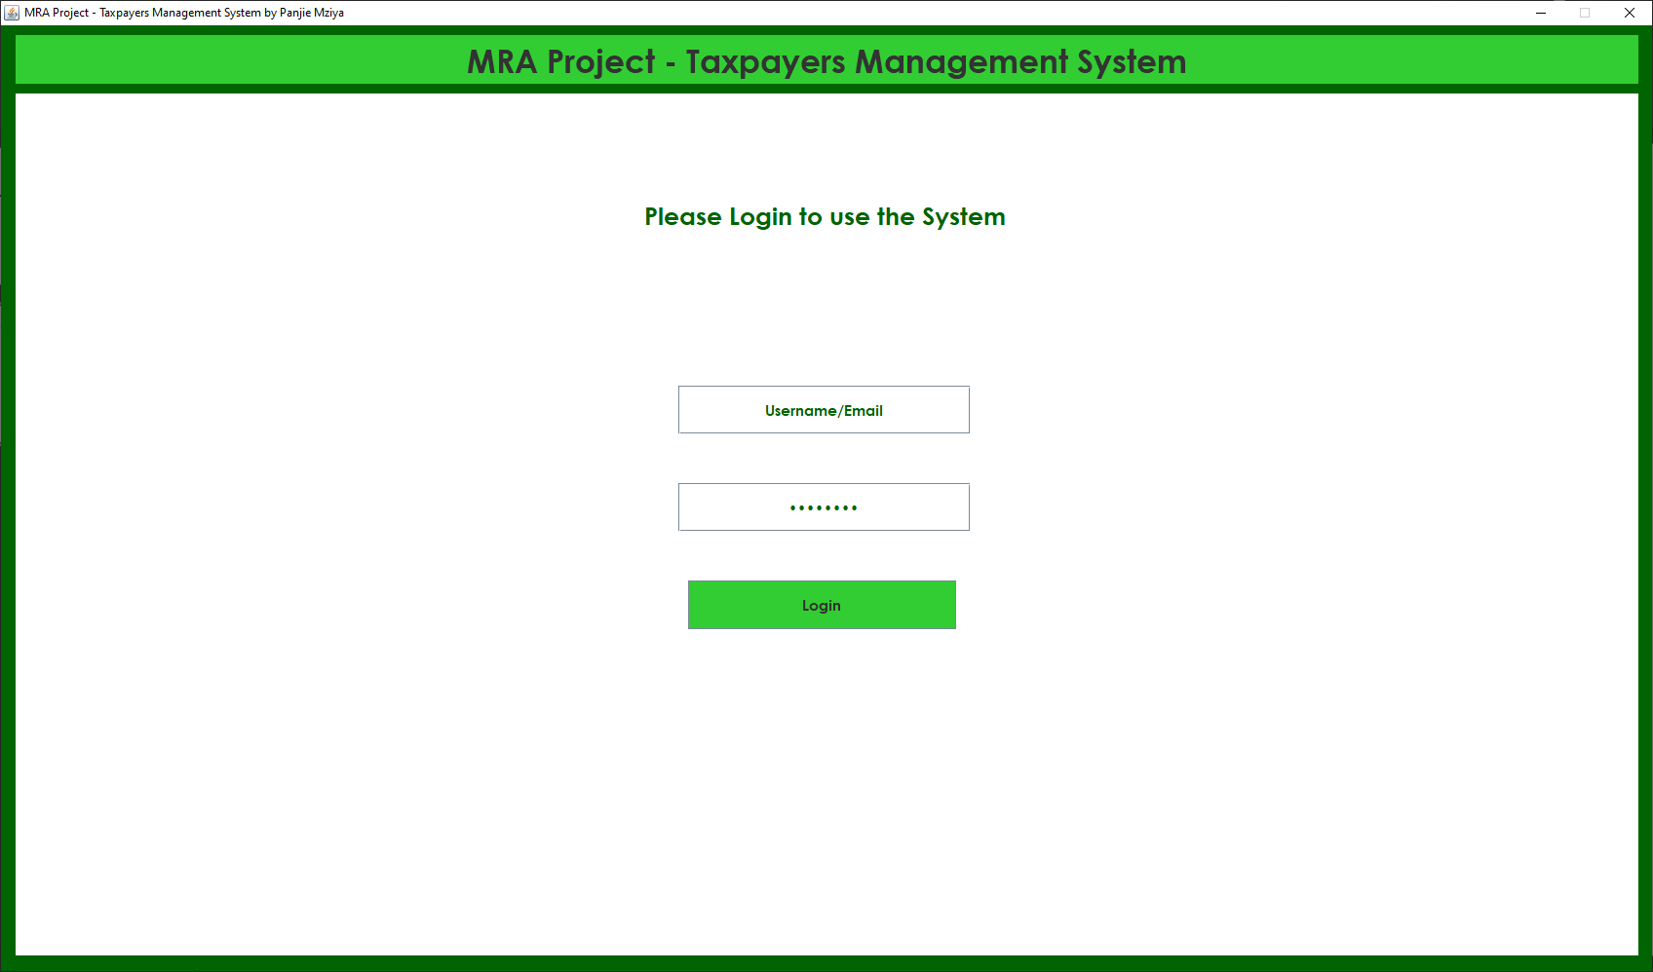
SYSTEM LOGIN

Slide 3
Login Window
Username field
Password field
Login button.

Slide 4
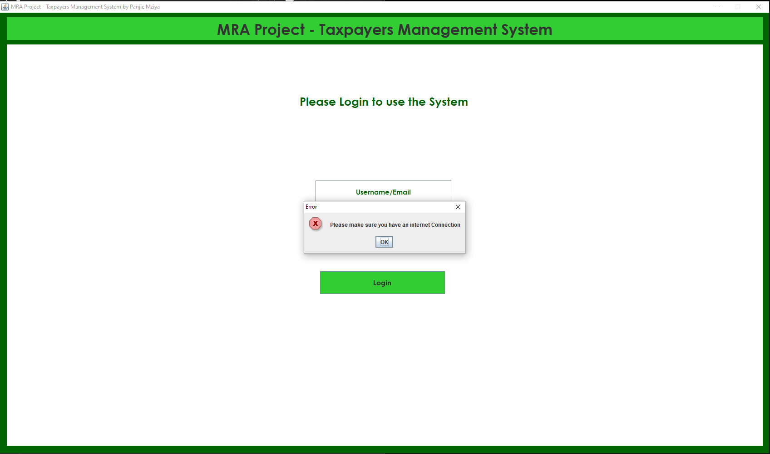

Slide 5
System checks for internet
System notifies user if no internet access

Slide 6
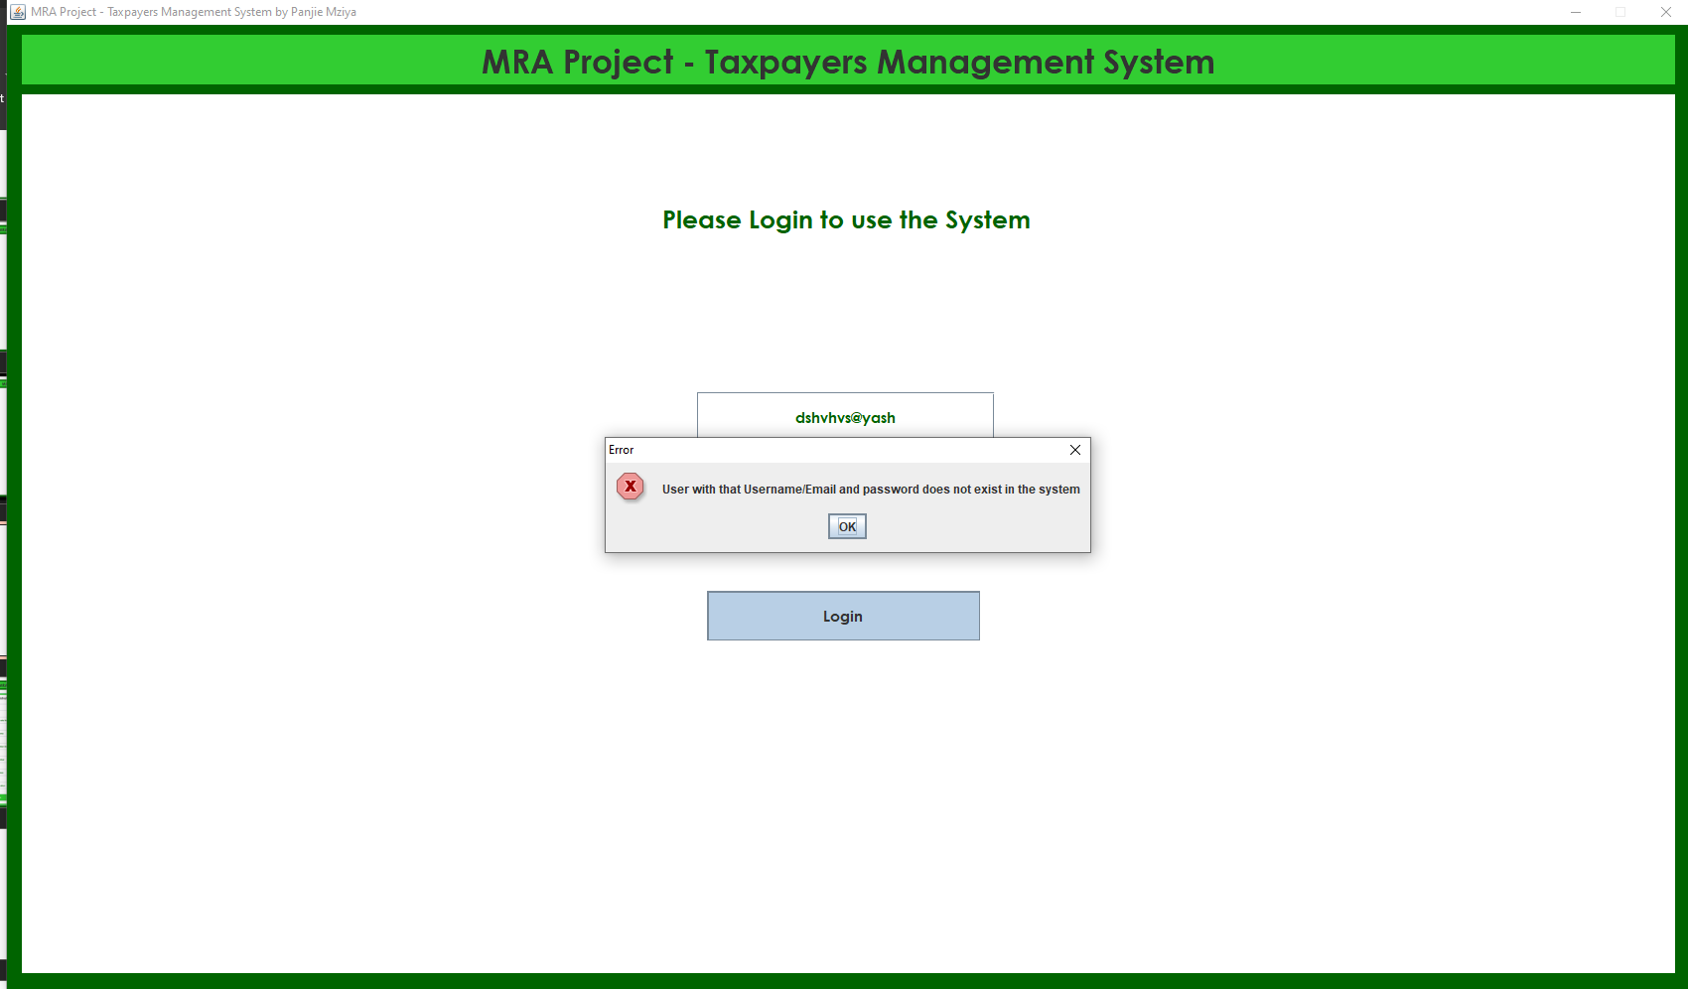

Slide 7
Denied access
User not allowed access because of untheorized credentials

Slide 8
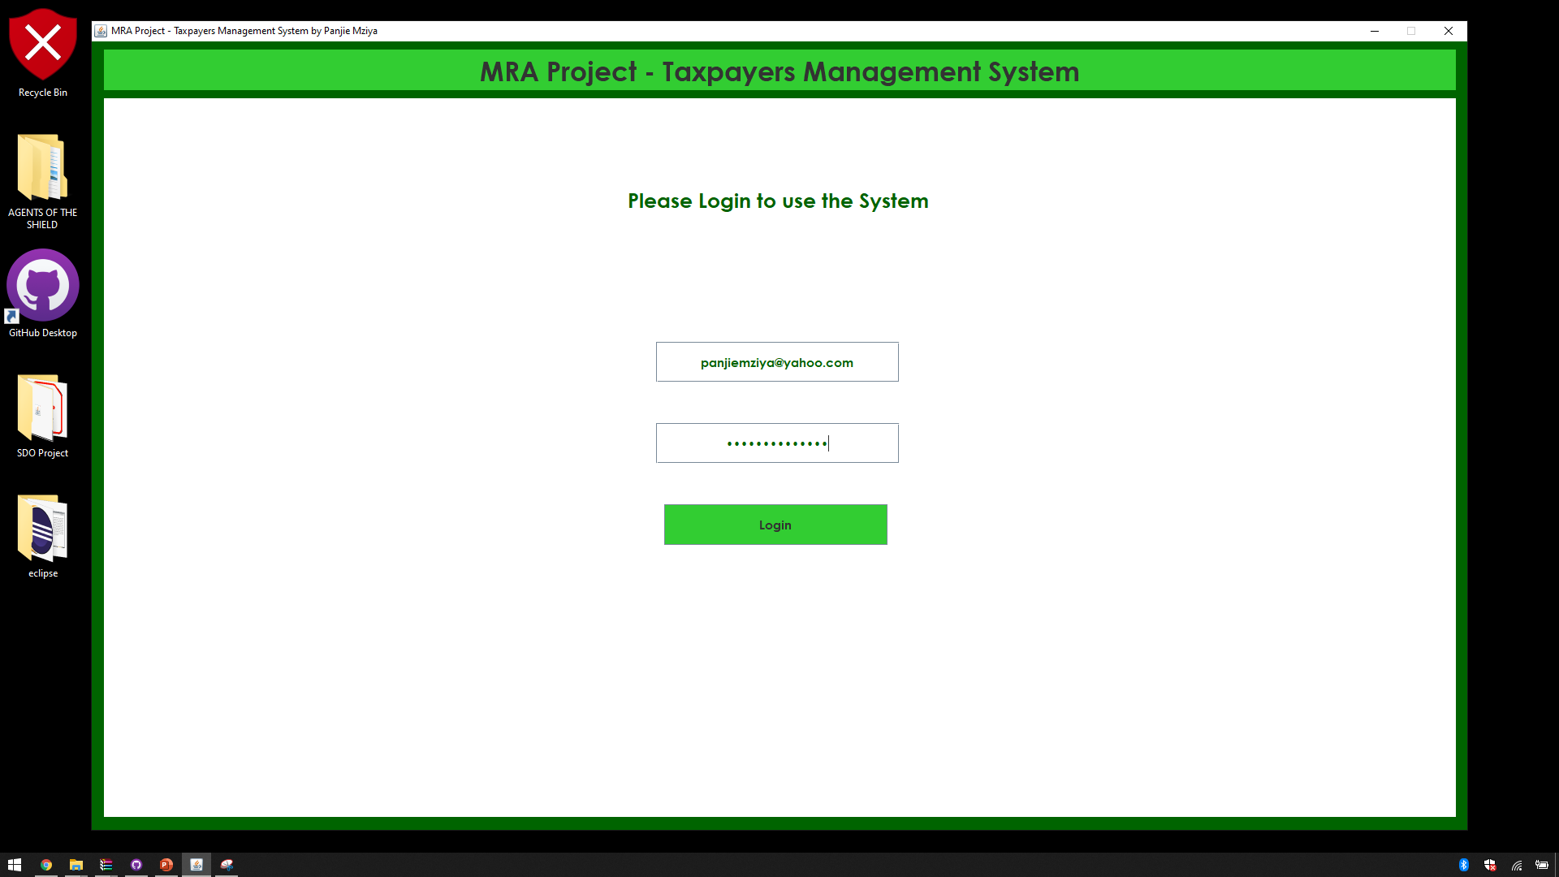

Slide 9
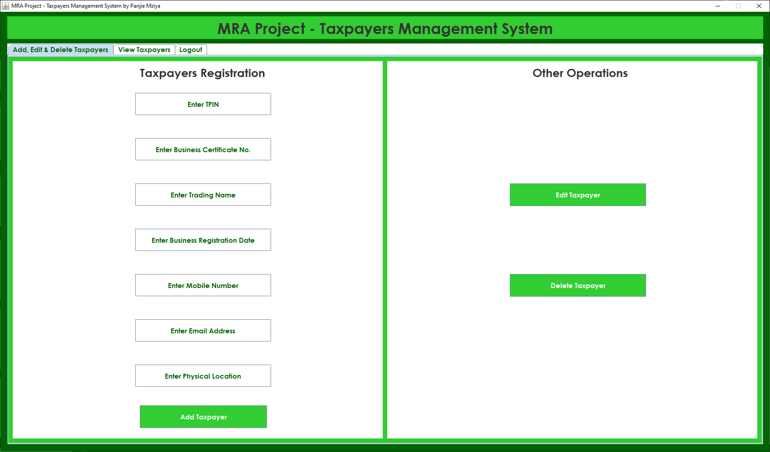

Slide 10
After Login
User enters right credentials and logins the system.
A window with three tabs including the one that lets users logout.
Adding, editing and deleting Taxpayer window has all options on the first panel that appears.
Second tab lets users view taxpayers

Slide 11
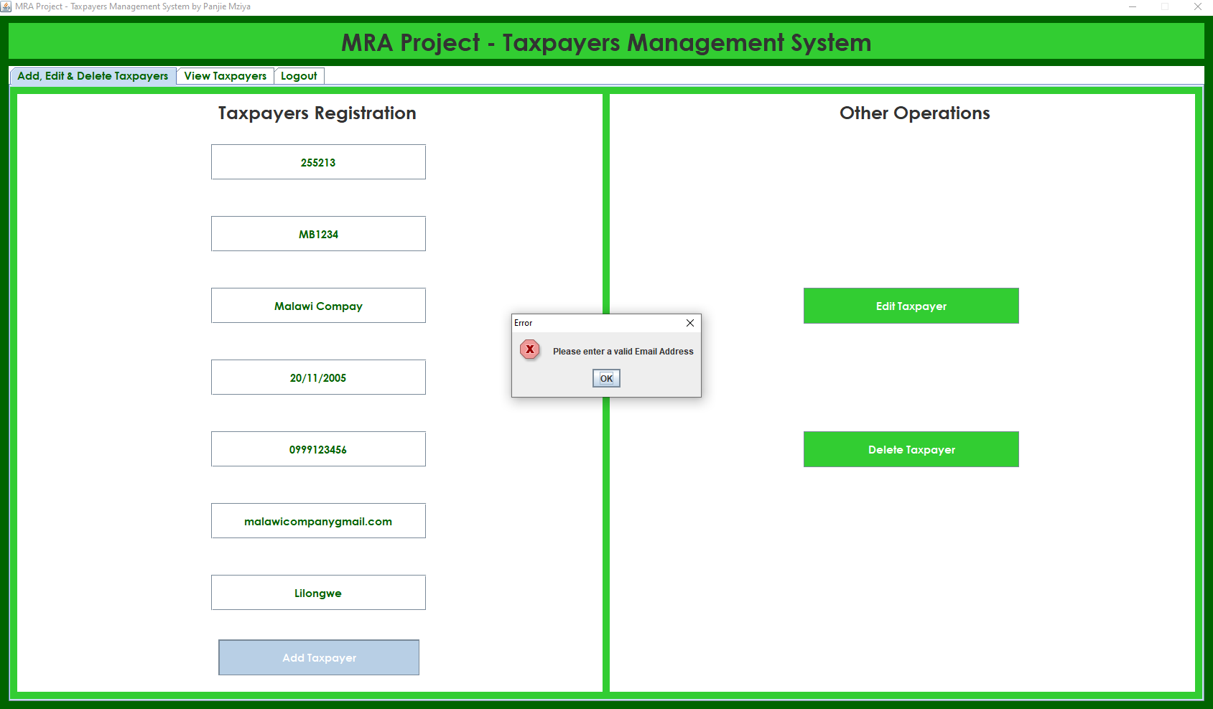

Slide 12
Data validation
User attempts to login with an invalid email address.
Just one way to show the data validation mechanisms put in place.

Slide 13
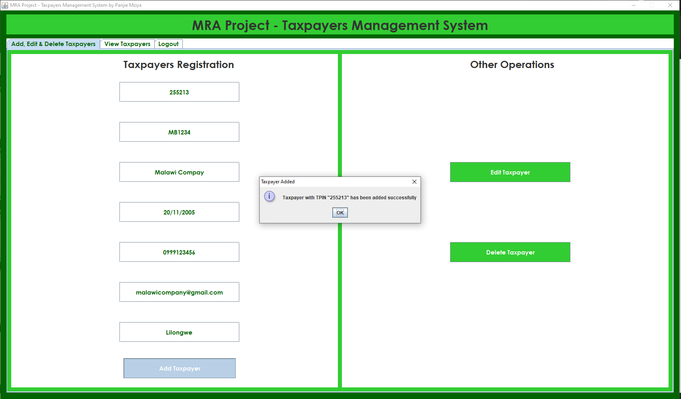

Slide 14
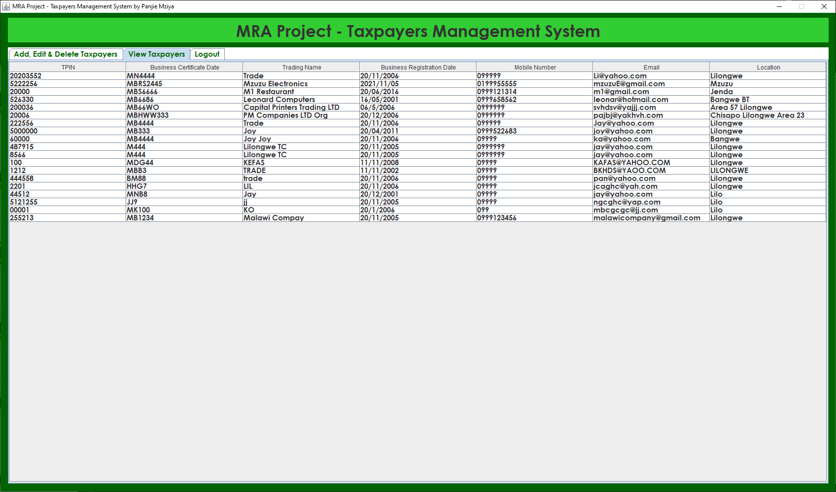

Slide 15
Adding and viewing added taxpayer
Keep a close eye on the details entered.
The view tab lets users see all the registered taxpayers.
You will see the newly registered taxpayer at the buttom.

Slide 16
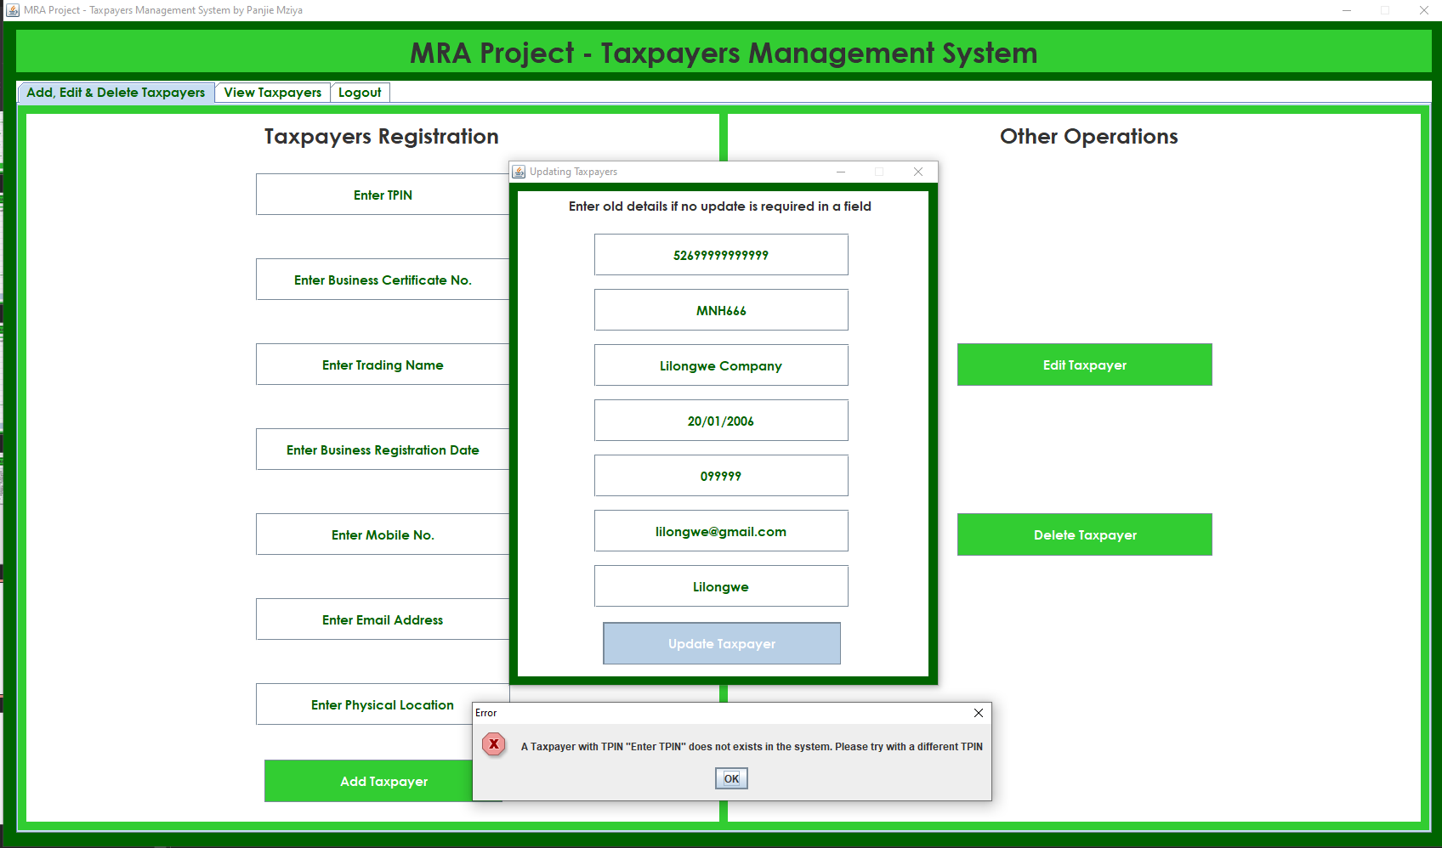

Slide 17
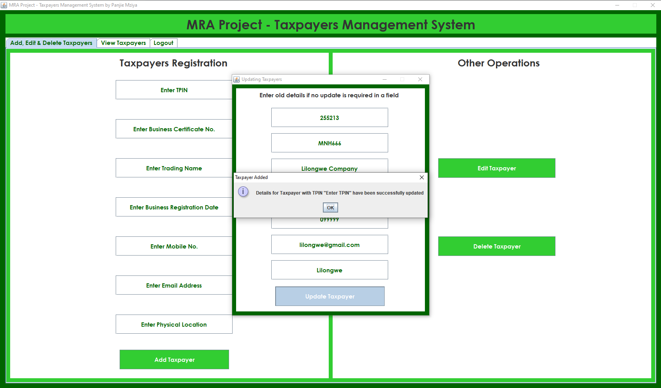

Slide 18


Slide 19
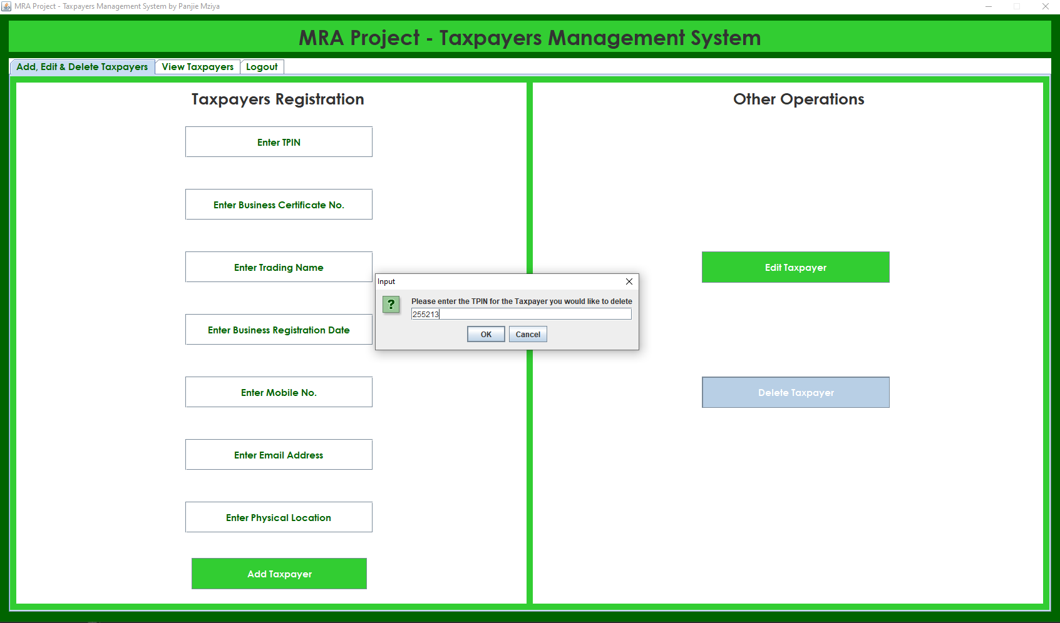

Slide 20
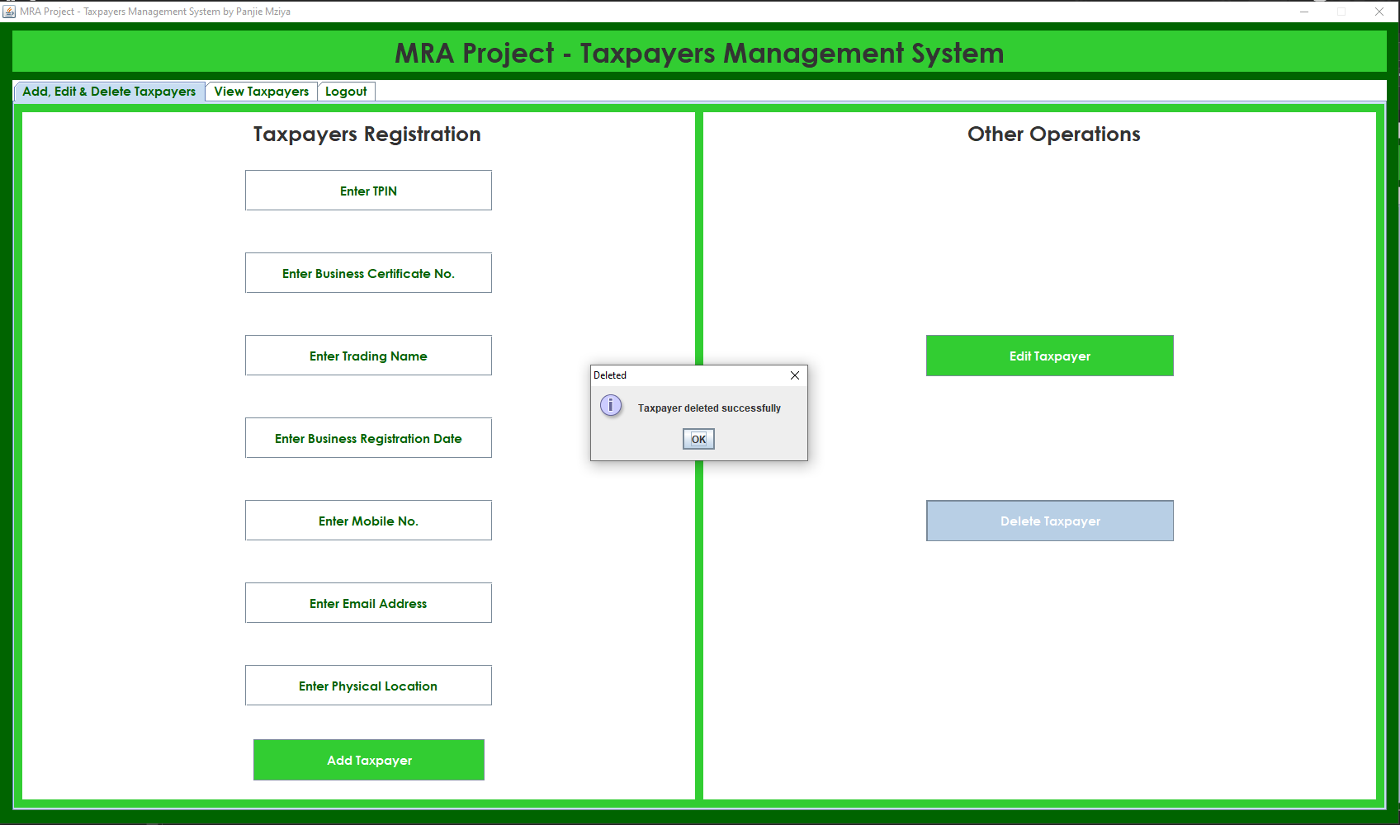

Slide 21
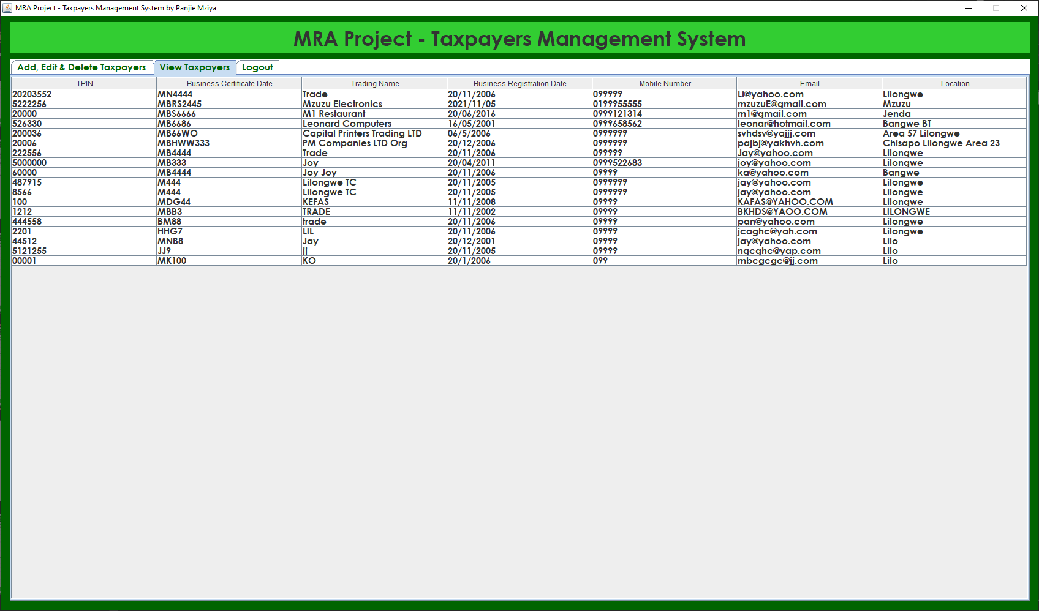

Slide 22
